Slide 1
Impact Study of Omicron on Credit Card Sales
Citi Finance
Notes:
‹#›

Slide 2
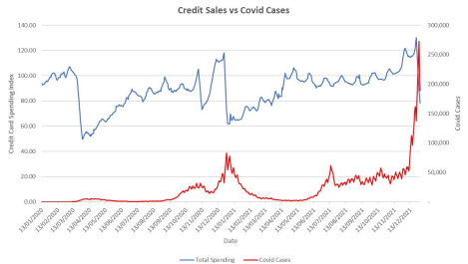
Credit Card Sales vs. COVID-19 Cases
Negative relationship between credit card sales and COVID-19 case increase
However, when Omicron appeared there is less of a drop in credit card sales potentially due to vaccines

Slide 3
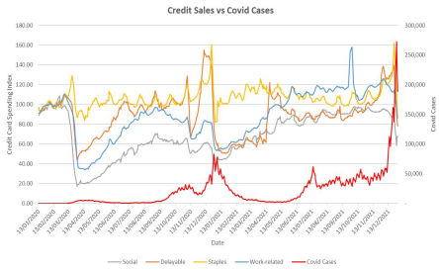
Detailed Credit Card Sales vs. COVID-19 Cases
Staple product spending was not exactly affected by COVID-19 other than occasional increase potentially due to stock up
Social spending dropped significantly and much more so than any other categories and it was also affected drastically by Omicron
Delayable dropped but recovered based on seasonal trends
Work related spending has dropped and as Omicron appeared there was also a significant drop

Slide 4
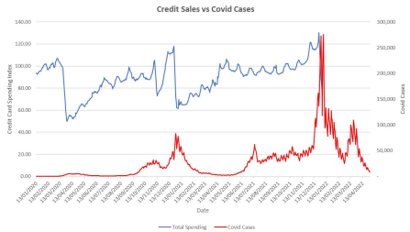
Expected Impact of Omicron on Credit Card Sales
Omicron affect spendings but not as much as when COVID-19 first began
As Omicron cases increase, there should be a drop in credit card sales but it shouldn’t be as significant of a drop as before
Staple product should be largely unaffected
Work-related, delayable, and social spendings will still be decrease for the foreseeable time

